Slide 1
Categorical Data
Prof. Andy Field

Slide 2
Aims
Categorical data
  Contingency tables
  chi-square test
  Likelihood ratio
  Odds ratio
Loglinear models
  Theory
  Assumptions
  Interpretation

Slide 3
Categorical Data
Sometimes we have data consisting of the frequency of cases falling into unique categories
Examples:
  Number of people voting for different politicians
  Numbers of students who pass or fail their degree in different subject areas
  Number of patients or waiting list controls who are ‘free from diagnosis’ (or not) following a treatment

Slide 4
An Example: Dancing Cats and Dogs
Analysing two or more categorical variables
  The mean of a categorical variable is meaningless
    The numeric values you attach to different categories are arbitrary
    The mean of those numeric values will depend on how many members each category has.
  Therefore, we analyse frequencies
An example
  Can animals be trained to line-dance with different rewards?
  Participants: 200 cats
  Training
    The animal was trained using either food or affection, not both)
  Dance
    The animal either learnt to line-dance or it did not
  Outcome:
    The number of animals (frequency) that could dance or not in each reward condition
  We can tabulate these frequencies in a contingency table

Slide 5
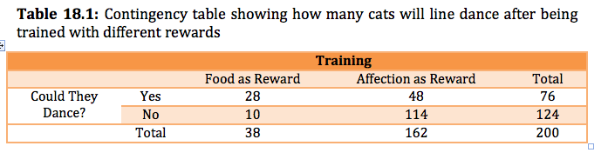
A Contingency Table

Slide 6
Pearson’s Chi-Square Test
Use to see whether there’s a relationship between two categorical variables
  Compares the frequencies you observe in certain categories to the frequencies you might expect to get in those categories by chance.
The equation:
  i represents the rows in the contingency table and j represents the columns.
  The observed data are the frequencies the contingency table
The ‘model’ is based on ‘expected frequencies’.
  Calculated for each of the cells in the contingency table.
  n is the total number of observations (in this case 200).
Test statistic
  Checked against a distribution with (r − 1)(c − 1) degrees of freedom.
  If significant then there is a significant association between the categorical variables in the population.
  The test distribution is approximate so in small samples use Fisher’s exact test.

Slide 7
Pearson’s Chi-Square Test

Slide 8
Likelihood Ratio Statistic
An alternative to Pearson’s chi-square, based on maximum-likelihood theory.
  Create a model for which the probability of obtaining the observed set of data is maximized
  This model is compared to the probability of obtaining those data under the null hypothesis
  The resulting statistic compares observed frequencies with those predicted by the model
  i and j are the rows and columns of the contingency table and ln is the natural logarithm
Test statistic
  Has a chi-square distribution with (r − 1)(c − 1) degrees of freedom.
  Preferred to the Pearson’s chi-square when samples are small.

Slide 9
Likelihood Ratio Statistic

Slide 10
Interpreting Chi-Square
The test statistic gives an ‘overall’ result.
We can break this result down using standardized residuals.
There are two important things about these standardized residuals:
  Standardized residuals have a direct relationship with the test statistic (they are a standardized version of the difference between observed and expected frequencies).
  These standardized are z-scores (e.g. if the value lies outside of the range between –1.96 and +1.96 then it is significant at p < .05).
Effect Size
  The odds ratio can be used as an effect size measure.

Slide 11
Important Points
The chi-square test has two important assumptions:
  Independence:
    Each person, item or entity contributes to only one cell of the contingency table.
  The expected frequencies should be greater than 5.
    In larger contingency tables up to 20% of expected frequencies can be below 5, but there a loss of statistical power.
    Even in larger contingency tables no expected frequencies should be below 1.
    If you find yourself in this situation consider using Fisher’s exact test.
Proportionately small differences in cell frequencies can result in statistically significant associations between variables if the sample is large enough
  Look at row and column percentages to interpret effects.

Slide 12
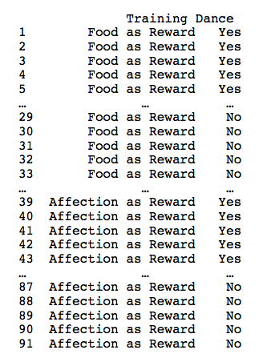
Entering Data: Raw Scores

Slide 13

Entering Data: the Contingency Table
  food <- c(10, 28)
  affection <- c(114, 48)
  catsTable <- cbind(food, affection)
The resulting data look like this:

Slide 14
Running the Analysis with
R Commander

Slide 15
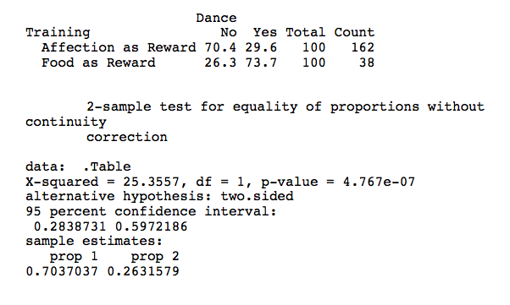
The Chi-square Test Using
R Commander

Slide 16
Running the Analysis using R
For raw data, the function takes the basic form:
  CrossTable(predictor, outcome, fisher = TRUE, chisq = TRUE, expected = TRUE, sresid = TRUE, format = "SAS"/"SPSS")
and for a contingency table:
  CrossTable(contingencyTable, fisher = TRUE, chisq = TRUE, expected = TRUE, sresid = TRUE, format = "SAS"/"SPSS")

Slide 17
Running the Analysis using R
To run the chi-square test on our cat data, we could execute
  CrossTable(catsData$Training, catsData$Dance, fisher = TRUE, chisq = TRUE, expected = TRUE, sresid = TRUE, format = "SPSS")
on the raw scores (i.e., the catsData dataframe), or
  CrossTable(catsTable, fisher = TRUE, chisq = TRUE, expected = TRUE, sresid = TRUE, format = "SPSS")

Slide 18
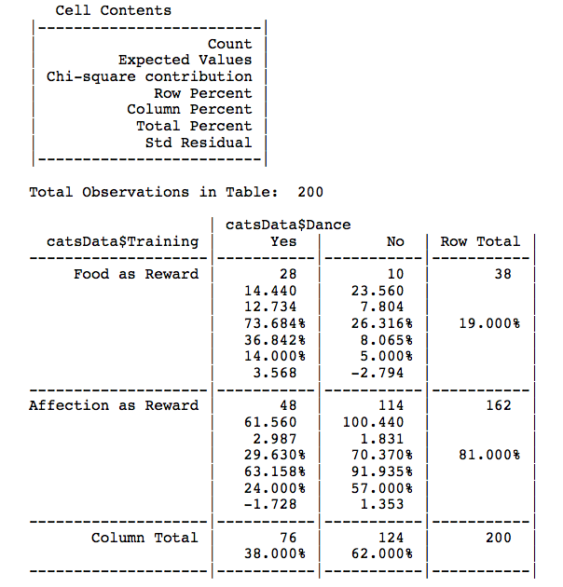
Output from the CrossTable() Function

Slide 19
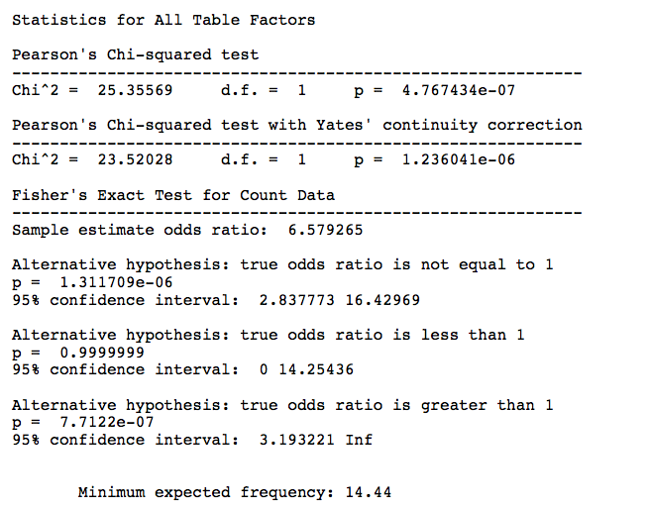

Slide 20
The Odds Ratio

Slide 21
Interpretation
There was a significant association between the type of training and whether or not cats would dance χ²(1) = 25.36, p < .001. This seems to represent the fact that, based on the odds ratio, the odds of cats dancing were 6.58 (2.84, 16.43) times higher if they were trained with food than if trained with affection.

Slide 22
Loglinear Analysis
When?
  To look for associations between three or more categorical variables
Example: dancing dogs
  Same example as before but with data from 70 dogs.
  Animal
    Dog or cat
  Training
    Food as reward or affection as reward
  Dance
    Did they dance or not?
  Outcome:
    Frequency of animals

Slide 23
Theory
Our model has three predictors and their associated interactions:
  Animal, Training, Dance, Animal × Training, Animal × Dance, Dance × Training, Animal × Training × Dance
Such a linear model can be expressed as:
A loglinear Model can also be expressed like this, but the outcome is a log value:
=
(
+
+
+
+
+
+
+
)
Outcome
b
b
A
b
B
b
C
b
AB
b
AC
b
BC
b
ABC
+
ε
i
0
1
2
3
4
5
6
7
i
(
)
(
)
(
)
ln
O
=
b
+
b
A
+
b
B
+
b
C
+
b
AB
+
b
AC
+
b
BC
+
b
ABC
+
ln
ε
ijk
0
1
i
2
j
3
k
4
ij
5
ik
6
jk
7
ijk
ijk

Slide 24
Backward Elimination
Begins by including all terms:
  Animal, Training, Dance, Animal × Training, Animal × Dance, Dance × Training, Animal × Training × Dance
Remove a term and compares the new model with the one in which the term was present:
  Starts with the highest-order interaction.
  Uses the likelihood ratio to ‘compare’ models:
  If the new model is no worse than the old, then the term is removed and the next highest-order interactions are examined, and so on.

Slide 25
Assumptions
Independence
  An entity should fall into only one cell of the contingency table.
Expected frequencies
  It’s all right to have up to 20% of cells with expected frequencies less than 5; however, all cells must have expected frequencies greater than 1. If this assumption is broken the result is a radical reduction in test power.
Remedies for problems with expected frequencies:
  Collapse the data across one of the variables:
    The highest-order interaction should be non-significant.
    At least one of the lower-order interaction terms involving the variable to be deleted should be non-significant.
  Collapse levels of one of the variables:
    Only if it makes theoretical sense.
  Collect more data.
  Accept the loss of power (not really an option given how drastic the loss is).

Slide 26
Loglinear Analysis Using R
Data are entered for loglinear analysis in the same way as for the chi-square test.
To create the separate dataframes for cats and dogs, we execute:
  justCats = subset(catsDogs, Animal=="Cat")
  justDogs = subset(catsDogs, Animal=="Dog")
Having created these two new dataframes, we can use the CrossTable() command to generate contingency tables for each of them by executing:
  CrossTable(justCats$Training, justCats$Dance, sresid = TRUE, prop.t = FALSE, prop.c = FALSE, prop.chisq = FALSE, format = "SPSS")
  CrossTable(justDogs$Training, justDogs$Dance, sresid = TRUE, prop.t = FALSE, prop.c = FALSE, prop.chisq = FALSE, format = "SPSS")

Slide 27
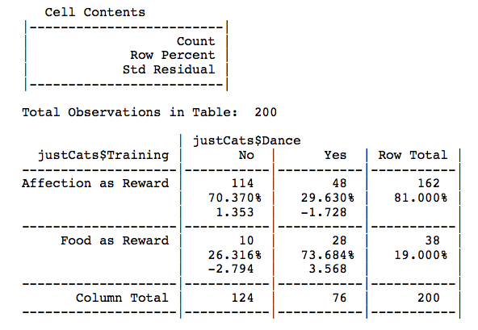
Cat Contingency Table

Slide 28
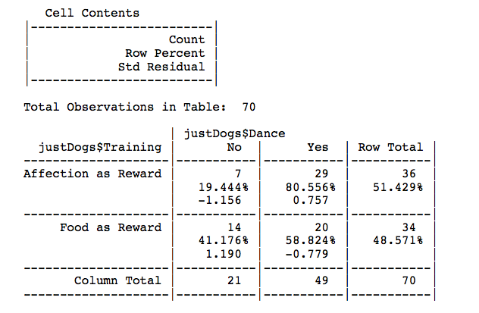
Dog Contingency Table

Slide 29

Loglinear Analysis as a Chi-Square Test
The first stage, is to create a contingency table to put into the loglm() function; we can do this using the xtabs() function:
  catTable<-xtabs(~ Training + Dance, data = justCats)
We input this object into loglm().

Slide 30
Loglinear Analysis as a Chi-Square Test
Model 1:
  catSaturated<-loglm(~ Training + Dance + Training:Dance, data = catTable, fit = TRUE)
Model 2:
  catNoInteraction<-loglm(~ Training + Dance, data = catTable, fit = TRUE)

Slide 31
Mosaic Plot
To do a mosaic plot in R, we can use the mosaicplot() function:
  mosaicplot(catSaturated$fit, shade = TRUE, main = "Cats: Saturated Model")

Slide 32
Mosaic Plot

Slide 33
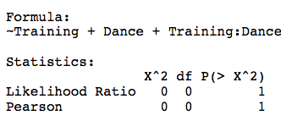
Output from Loglinear Analysis as a Chi-Square Test
Output of the saturated model:

Slide 34
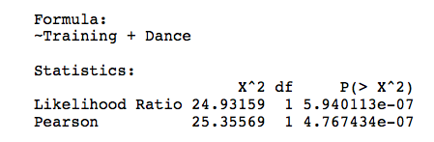
Output from Loglinear Analysis as a Chi-Square Test
Output of the model without the interaction term

Slide 37
Loglinear Analysis
First of all we need to generate our contingency table using xtabs() and we can do this by executing:
  CatDogContingencyTable<-xtabs(~ Animal + Training + Dance, data = catsDogs)
We start by estimating the saturated model, which we know will fit the data perfectly with a chi-square equal to zero. We’ll call the model caturated. We can create this model in the same way as before:
  caturated<-loglm(~ Animal*Training*Dance, data = CatDogContingencyTable)

Slide 38
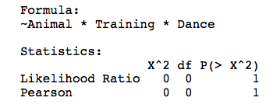
Loglinear Analysis: the Saturated Model
  summary(caturated)

Slide 39
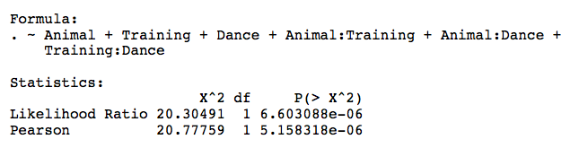
Loglinear Analysis: Model without Three-Way Interaction
Next we’ll fit the model with all of the main effects and two way interactions:
  threeWay<-update(caturated, .~. -Animal:Training:Dance)
  summary(threeWay)

Slide 40
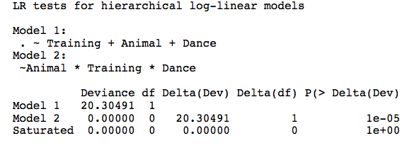
Loglinear Analysis: Comparing Models
  anova(caturated, threeWay)

Slide 41
Interpreting the Three-Way Interaction
The next step is to try to interpret the three-way interaction.
We can obtain a mosaic plot by using the mosaicplot() function and applying it to our contingency table:
  mosaicplot(CatDogContingencyTable, shade = TRUE, main = "Cats and Dogs")

Slide 43
Following up with Chi-Square Tests
An alternative way to interpret a three-way interaction is to conduct chi-square analysis at different levels of one of your variables.
For example, to interpret our animal × training × dance interaction, we could perform a chi-square test on training and dance but do this separately for dogs and cats.
  In fact the analysis for cats will be the same as the example we used for chi-square.
You can then compare the results in the different animals.

Slide 44
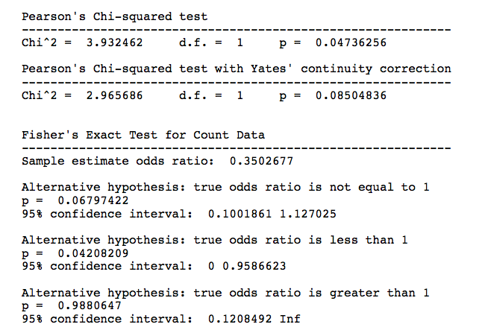
Following up with Chi-Square Tests

Slide 45
The Odds Ratio for Dogs

Slide 46
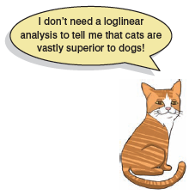
Interpretation
The three-way loglinear analysis produced a final model that retained all effects. The likelihood ratio of this model wasχ² (0) = 0, p = 1. This indicated that the highest-order interaction (the animal × training × dance interaction) was significant, χ² (1) = 20.31, p < .001.
To break down this effect, separate chi-square tests on the training and dance variables were performed separately for dogs and cats. For cats, there was a significant association between the type of training and whether or not cats would dance, χ² (1) = 25.36, p < .001; this was true in dogs also, χ² (1) = 3.93, p < .05. Odds ratios indicated that the odds of dancing were 6.58 higher after food than after affection in cats, but only 0.35 in dogs (i.e., in dogs, the odds of dancing were 2.90 times lower if trained with food compared to affection). Therefore, the analysis seems to reveal a fundamental difference between dogs and cats: cats are more likely to dance for food rather than affection, whereas dogs are more likely to dance for affection than food.

Slide 47
To Sum Up …
We approach categorical data in much the same way as any other kind of data:
  We fit a model, we calculate the deviation between our model and the observed data, and we use that to evaluate the model we’ve fitted.
  We fit a linear model.
Two categorical variables
  Pearson’s chi-square test
  Likelihood ratio test
Three or more categorical variables
  Loglinear model
  For every variable we get a main effect
  We also get interactions between all combinations of variables
  Loglinear analysis evaluates these effects hierarchically
Effect sizes
  The odds ratio is a useful measure of the size of effect for categorical data

